Slide 1
Desuggestopedia

Slide 2
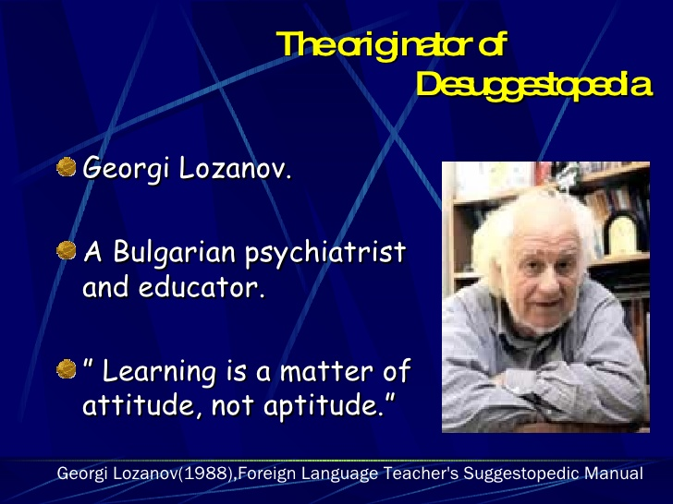
Introduction

Slide 3
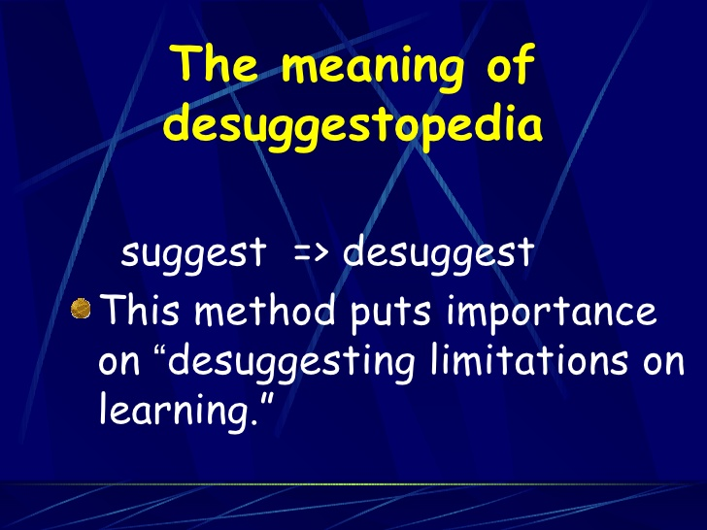

Slide 4
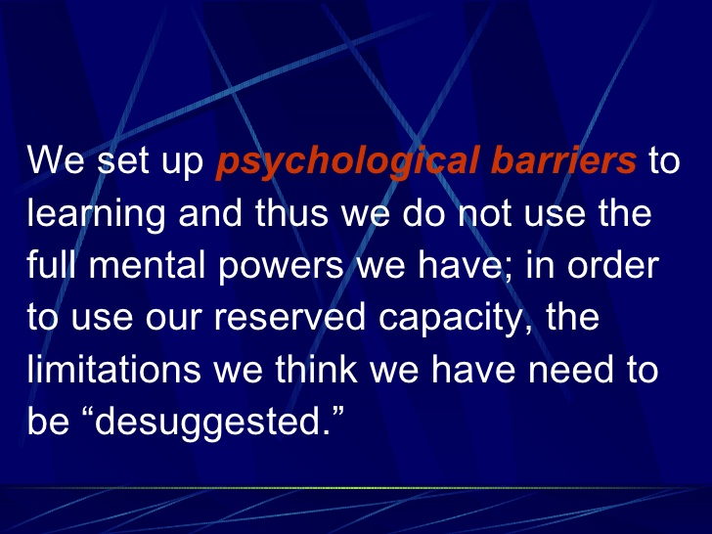

Slide 5
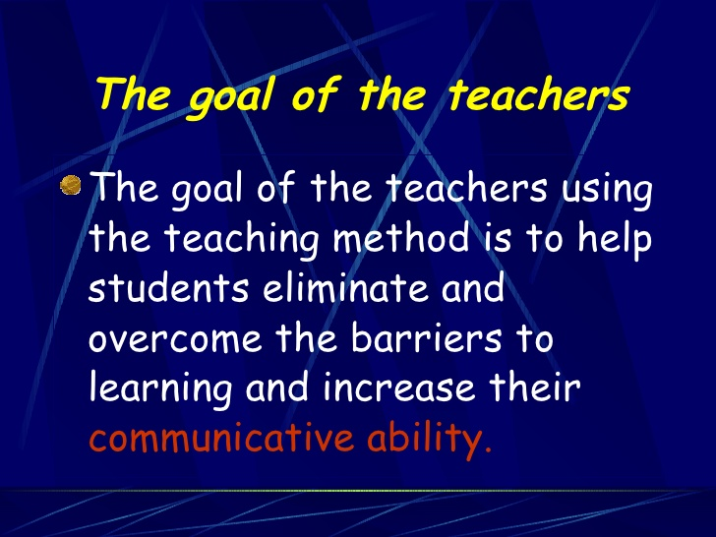

Slide 6
The class meets for two hours, three mornings a week
Bright , colourful ( paintings and posters ) classroom ( Peripheral Learning )
First Meeting
Teacher greeting and introduction in students’ native language ( to make them feel safe and confident )
New Identity

Slide 7
Presenting the dialogue
1. distributing the scripts in two languages
2. teacher briefly mentions a few points about the dialogue story, grammar and vocabulary in native language, target language or pantomime
3. First reading ( slowly with music accompaniment and dramatization )
4. Second reading ( normal speed with different music )

Slide 8
5. The students stand and repeat after the teacher, joining their voices to the music and dramatize the dialogue
6. Taking a break
7. Third reading ( normal speed, music accompaniment , the students listen without their scripts )
8. Homework : reading the dialogue once before going to bed and once when getting up in the morning

Slide 9
Second Class
Role – play : dividing students into groups, playing roles from the dialogue, each group reads the dialogue in a different mode ( angrily, cheerfully, sadly, … etc )
Teacher asks questions about the dialogue in the target language, asking students to translate from and into the target language

Slide 10
Singing a song
Playing wh-questions games about the new identity by using a medium-sized soft ball
No Homework other than reading the dialogue
Third class : working more with the same dialogue ( more games, role-play, asking questions and repetition )

Slide 11
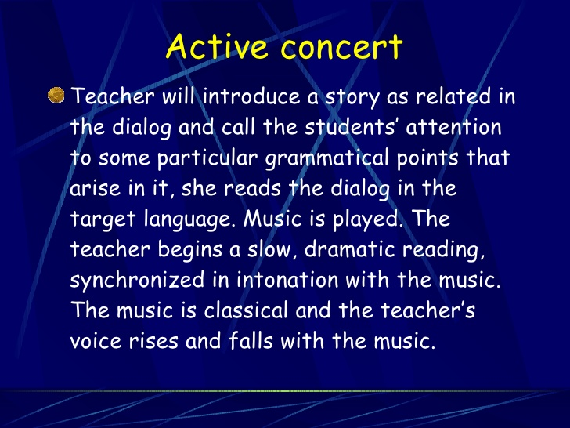

Slide 12
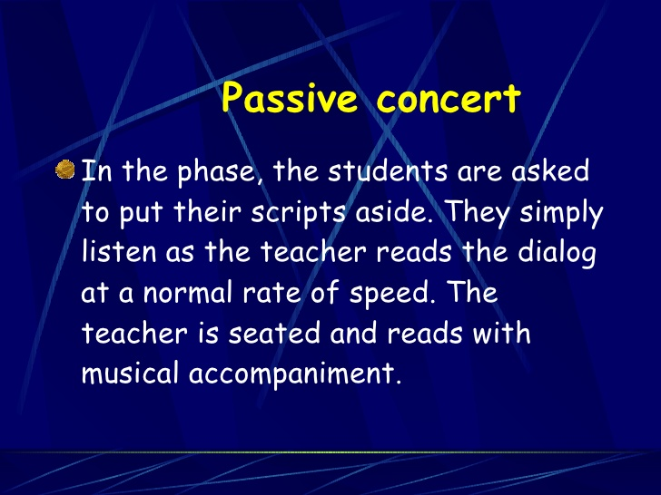

Slide 13
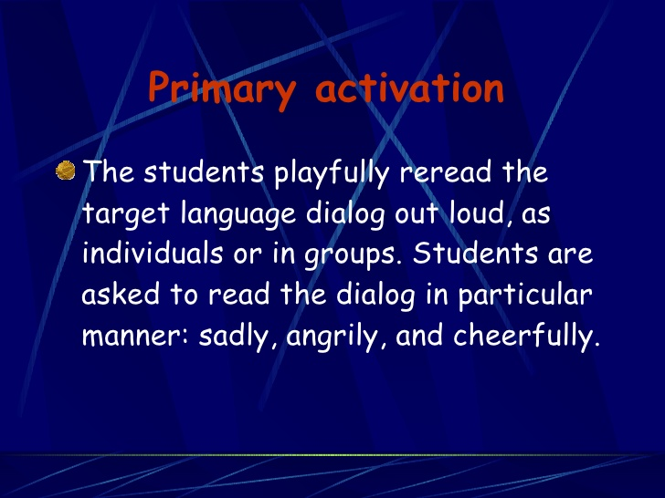

Slide 14
Creative Adaptation
The students engage in various activities designed to help them learn the new material and use it spontaneously through singing, dramatization and games. The important things is that the activities are varied and do not allow students to focus on the form of the linguistic message, just the communicative function.

Slide 15
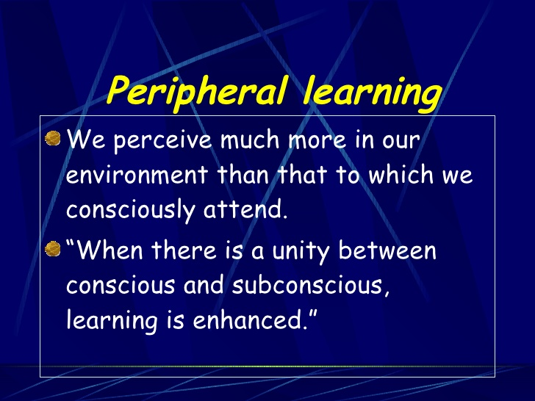
Comment :

Slide 16
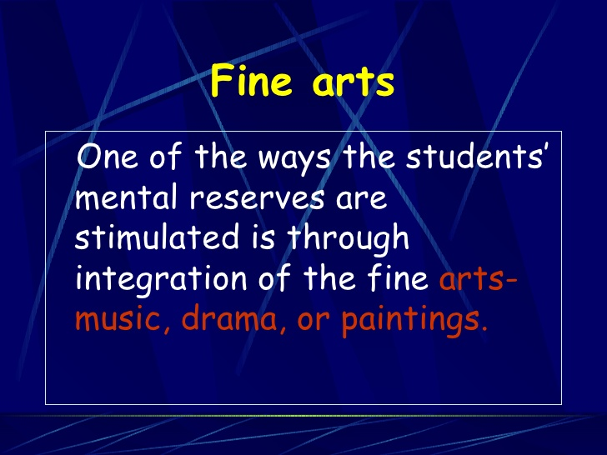
Comment :

Slide 17
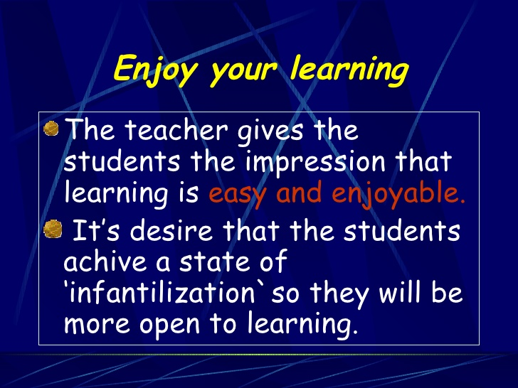
Comment :

Slide 18
Comment
Choosing a new identity
This enhances students’ feelings of security and allows them to be more open.

Slide 19
Principles
Teacher’s Goals :
To accelerate the process of foreign language learning for everyday communication
To desuggest learners’ psychological barriers

Slide 20
2. Teacher’s / Students’ Roles
The teacher’s roles :
Source of authority being confident and trustable
Source of security affording a cheerful classroom atmosphere
The students’ roles :
Relaxed : following the teacher’s instructions
Role-play : enjoying the new identity and perform the dialogue

Slide 21
3. Characteristics of the teaching/learning process
Classroom atmosphere
New Identity
Teaching the dialogue
Receptive phase ( Active & Passive concerts )
Active phase

Slide 22
4. Interaction
The teacher initiates interaction
( Teacher Students )
Students can respond to teacher nonverbally or with little target language until they achieve progress
( Students Teacher )
Students interact with each other through role-play and games
( Student Student )

Slide 23
5. Students’ Feelings
Relaxed : Students’ psychological barriers are desuggested
Confident :
the target language comes naturally
Success is obtainable
Secure : new identity and native language
Teacher achieves this through
Direct positive suggestion
Indirect positive suggestion

Slide 24
6. Language / Culture
Communication is achieved through two levels : Language and some factors affecting the linguistic message interpretation like nonverbal behaviour.
Culture that is taught concerns the everyday life of the target language native speakers. It should be presented to students through fine arts, mainly painting.

Slide 25
7. Language Components / Skills
Vocabulary is emphasized.
Grammar is taught explicitly but minimally, to a limited extent, since the focus should be on communication and not the language form.
Speaking communicatively is important.
Reading is done ( reading the dialogue or passage )
Writing is also taught ( students write imaginative compositions )

Slide 26
8. Role of the Native Language
Translation to the native language is one of the ways the teacher resorts to to make meaning clear
The native language is also used by the teacher in explanations and giving instructions.
As the course proceeds, using the native language would become less and less.

Slide 27
9. Evaluation
No formal test is made since this would make learners uncomfortable.
Evaluation is conducted during normal in – class performance.

Slide 28
10. Error Correction
Errors are corrected by the teacher gently and with soft voice.

Slide 29
Advantages
It emphasizes learners’ feelings and works on creating a cheerful and comfortable environment for them.
Teacher has authority, which gives learners a sense of security( students remember best and are most influenced by information coming from an authoratative source, teachers)
It emphasizes that learning happens on two planes : conscious ( direct ) and subconscious ( indirect )

Slide 30
Advantages
It encourages learners to look for more sources other than the teacher to learn the language ( peripheral learning ).
It motivates learners to use the target language independently, take more responsibility and be more confident ( through the technique of new identity and creative adaptation )
Errors are corrected gently and indirectly

Slide 31
Disadvantages
It is not suitable for large classes
Decorating the classroom with paintings and posters that should be changed regularly can be expensive for some teachers
Not all learners may find music a source of relaxation
No tests are used to evaluate learners’ progress

